Slide 1
A Contextual-Bandit Approach to Personalized News Article Recommendation
Lihong Li, Wei Chu, John Langford, and Robert E. Schapire. 2010.
WWW '10: Proceedings of the 19th international conference on World wide web
Group 7:
Tommy - Tongle Shen,
Zach - Chenhao Zhu,
Shirley - Keyin Wang,
Andy - Yuxuan Yang

Slide 2
Table of Contents
Introduction : Andy - Yuxuan Yang
Algorithms : Tommy - Tongle Shen
Experiments : Zach - Chenhao Zhu
Conclusion : Shirley - Keyin Wang
Li, L., Chu, W., Langford, J., & Schapire, R. E. (2010). A contextual-bandit approach to personalized news article recommendation. In Proceedings of the 19th international conference on World wide web (WWW '10)

Slide 3
Part 1: Introduction
Lecturer: Andy – Yuxuan Yang
Li, L., Chu, W., Langford, J., & Schapire, R. E. (2010). A contextual-bandit approach to personalized news article recommendation. In Proceedings of the 19th international conference on World wide web (WWW '10)

Slide 4
Overview
Main issues
Fundamental concept
Key innovations
Li, L., Chu, W., Langford, J., & Schapire, R. E. (2010). A contextual-bandit approach to personalized news article recommendation. In Proceedings of the 19th international conference on World wide web (WWW '10)

Slide 5
Main issues
Dynamic Content: Traditional methods struggle to adapt model popularity and temporal changes
User-Content Variability: Personalized, feature-based approaches needed
Balancing Exploration & Exploitation: Crucial for long-term satisfaction
Li, L., Chu, W., Langford, J., & Schapire, R. E. (2010). A contextual-bandit approach to personalized news article recommendation. In Proceedings of the 19th international conference on World wide web (WWW '10)

Slide 6
Fundamental concept
Context-free bandits
No context used
Fixed action selection
Rewards based only on actions
Contextual bandits
Uses contextual information
Action selection based on context
Rewards depend on both actions and context
Li, L., Chu, W., Langford, J., & Schapire, R. E. (2010). A contextual-bandit approach to personalized news article recommendation. In Proceedings of the 19th international conference on World wide web (WWW '10)

Slide 7
Key innovations
LinUCB Algorithm:
Disjoint Linear Models: Fast adaptation using specific features
Hybrid Linear Models: Combines shared and specific features for better learning
Feature Engineering:User/Article features and dimensionality reduction enhance performance
Li, L., Chu, W., Langford, J., & Schapire, R. E. (2010). A contextual-bandit approach to personalized news article recommendation. In Proceedings of the 19th international conference on World wide web (WWW '10)

Slide 8
Part 2: Algorithms
Lecturer: Tommy - Tongle Shen
Li, L., Chu, W., Langford, J., & Schapire, R. E. (2010). A contextual-bandit approach to personalized news article recommendation. In Proceedings of the 19th international conference on World wide web (WWW '10)

Slide 9
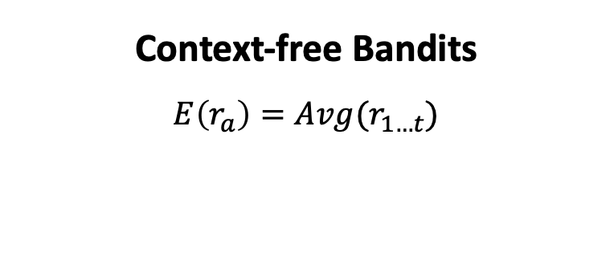
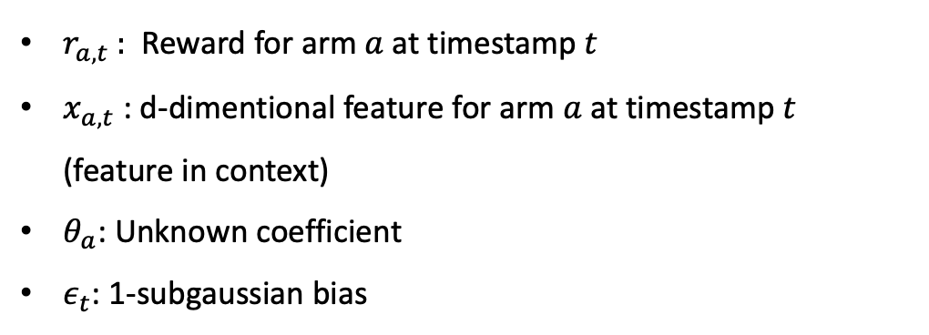

Reward Model for LinUCB
Context-free Bandits
$$E\left(r_{a}\right)=Avg(r_{1…t})$$
$r_{a,t}$ : Reward for arm $a$ at timestamp $t$
$x_{a,t}$: d-dimentional feature for arm $a$ at timestamp $t$ (feature in context)
$θ_{a}$: Unknown coefficient
$ε_{t}$: 1-subgaussian bias
Linear UCB
$$E\left(r_{a,t} | x_{a,t}\right)=x_{a,t }^{T}θ_{a}$$
$$r_{a,t}=x_{a,t }^{T}θ_{a}+ε_{t}$$
Li, L., Chu, W., Langford, J., & Schapire, R. E. (2010). A contextual-bandit approach to personalized news article recommendation. In Proceedings of the 19th international conference on World wide web (WWW '10)

Slide 10
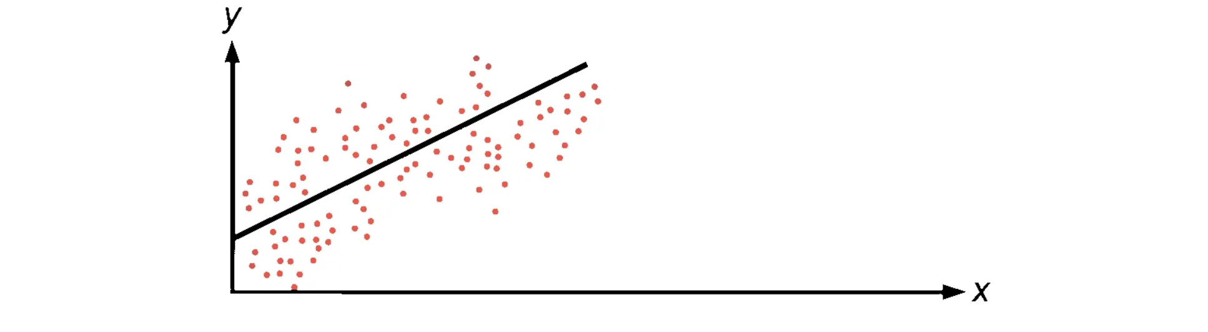

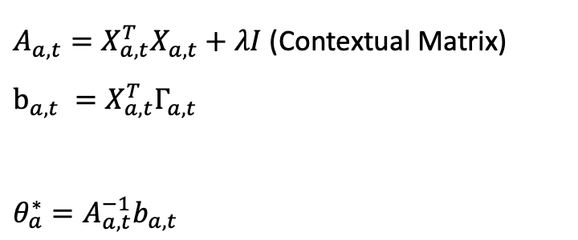


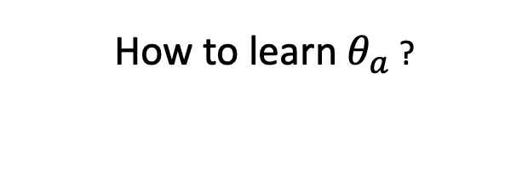
Reward Model for LinUCB
$$r_{a,t}=x_{a,t }^{T}θ_{a}+ε_{t}$$
How to learn $θ_{a}$ ?
Ridge Regression for linear models!
$X_{a,t}={\left[x_{a,1}, …, x_{a,t}\right]}^{T}$
$Γ_{a,t}={\left[r_{a,1}, …, r_{a,t}\right]}^{T}$
$θ_{a}^{∗}={\left(X_{a,t}^{T}X_{a,t}+λI\right)}^{−1}X_{a,t}^{T}Γ_{a,t}$
Keep it simple, we denote:
$A_{a,t}=X_{a,t}^{T}X_{a,t}+λI$ (Contextual Matrix)
$b_{a,t} =X_{a,t}^{T}Γ_{a,t}$
$θ_{a}^{∗}=A_{a,t}^{−1}b_{a,t}$
Li, L., Chu, W., Langford, J., & Schapire, R. E. (2010). A contextual-bandit approach to personalized news article recommendation. In Proceedings of the 19th international conference on World wide web (WWW '10)

Slide 11
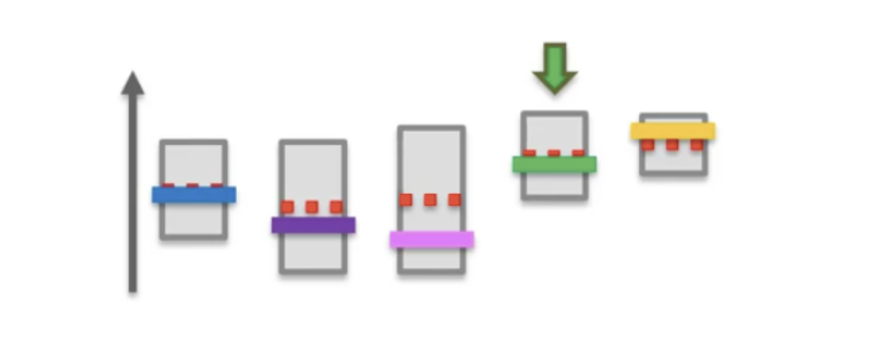
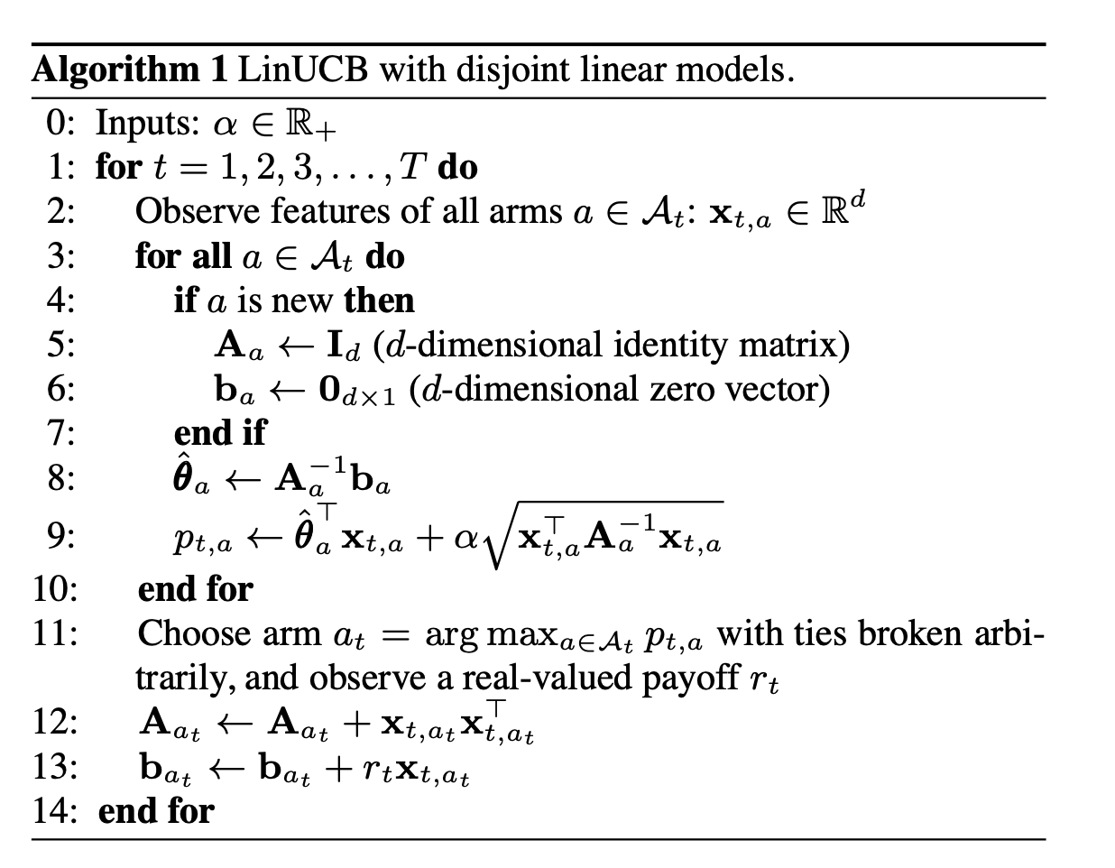


LinUCB Algorithm
Initialization
Update coefficient
Pick arm according to $α−$ stdvar UCB
Augment $A$ and $b$ for selected arm
Li, L., Chu, W., Langford, J., & Schapire, R. E. (2010). A contextual-bandit approach to personalized news article recommendation. In Proceedings of the 19th international conference on World wide web (WWW '10)

Slide 12


LinUCB hybrid version
Idea: Shared feature for each arm exists!
$$E\left(r_{a,t} | x_{a,t} , z_{t}\right)=x_{a,t }^{T}θ_{a}+z_{t}^{T}β_{a}$$
$$r_{a,t}=x_{a,t }^{T}θ_{a}+z_{t}^{T}β_{a}+ε_{t}$$
$x_{a,t}$: Separate feature for arm $a$ at timestamp $t$
$θ_{a}$: Unknown coefficient for separate feature
$z_{t}$: Shared feature for all arms at timestamp $t$
$β_{a}$: Unknown coefficient for shared feature
Li, L., Chu, W., Langford, J., & Schapire, R. E. (2010). A contextual-bandit approach to personalized news article recommendation. In Proceedings of the 19th international conference on World wide web (WWW '10)

Slide 13
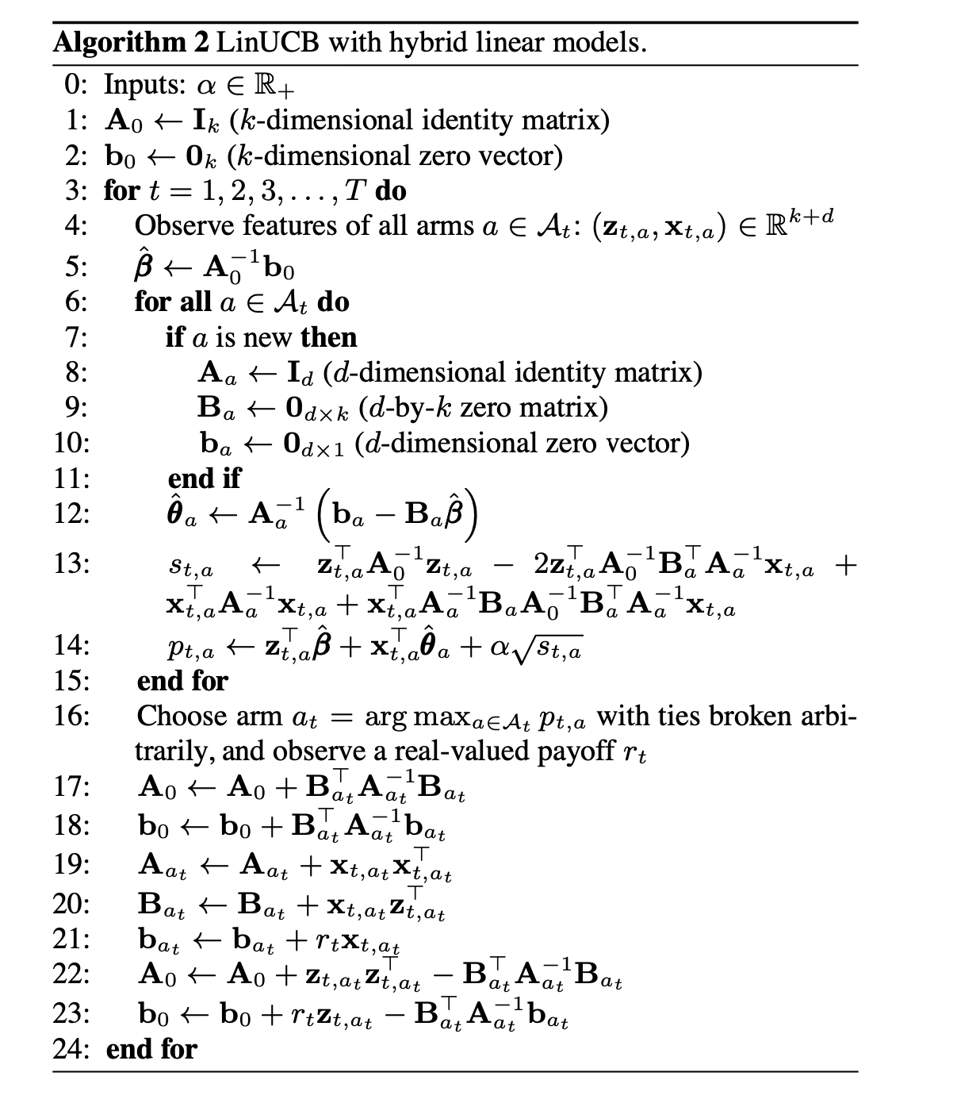
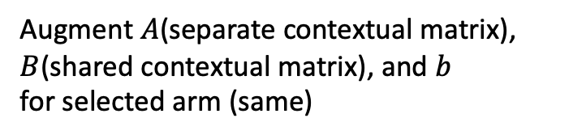
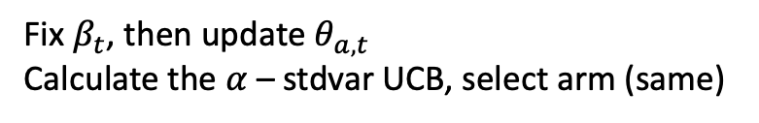

LinUCB hybrid Algorithm
Asynchronized update for two coefficients!
Update $β_{t}$ first
Fix $β_{t}$, then update $θ_{a,t}$
Calculate the $α$ – stdvar UCB, select arm (same)
Augment $A$(separate contextual matrix),
$B$(shared contextual matrix), and $b$
for selected arm (same)
Li, L., Chu, W., Langford, J., & Schapire, R. E. (2010). A contextual-bandit approach to personalized news article recommendation. In Proceedings of the 19th international conference on World wide web (WWW '10)

Slide 14
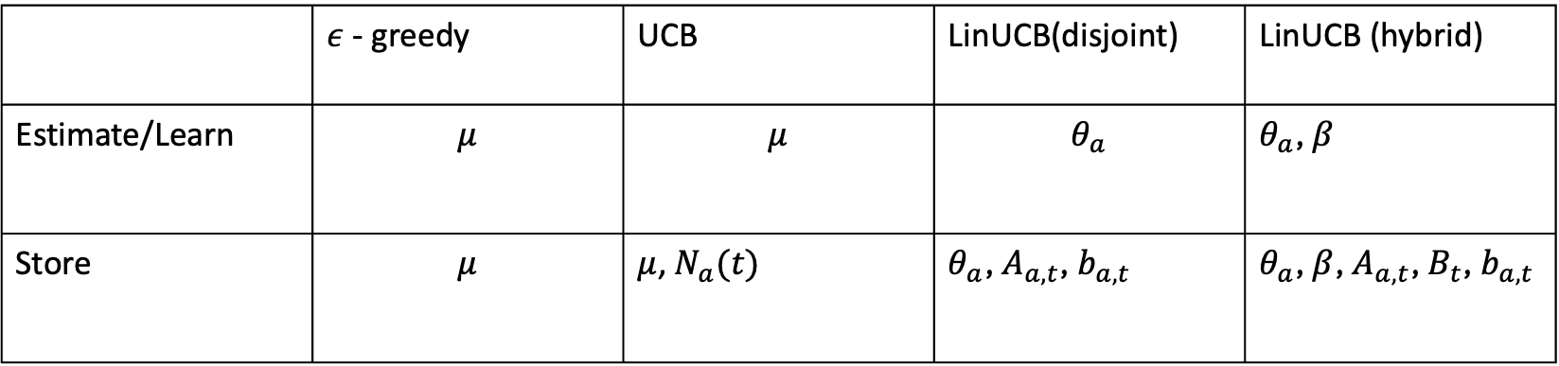
Recap for MABs
Context-free
Contextual
 | $ε$ - greedy | UCB | LinUCB(disjoint) | LinUCB (hybrid)
Estimate/Learn | $$μ$$ | $$μ$$ | $$θ_{a}$$ | $θ_{a}$, $β$
Store | $$μ$$ | $μ$,${ N}_{a}(t)$ | $θ_{a}$, $A_{a,t}$, $b_{a,t}$ | $θ_{a}$, $β$, $A_{a,t}$, $B_{t}$, $b_{a,t}$
Li, L., Chu, W., Langford, J., & Schapire, R. E. (2010). A contextual-bandit approach to personalized news article recommendation. In Proceedings of the 19th international conference on World wide web (WWW '10)

Slide 15
Part 3: Experiments
Lecturer: Zach - Chenhao Zhu
Li, L., Chu, W., Langford, J., & Schapire, R. E. (2010). A contextual-bandit approach to personalized news article recommendation. In Proceedings of the 19th international conference on World wide web (WWW '10)

Slide 16
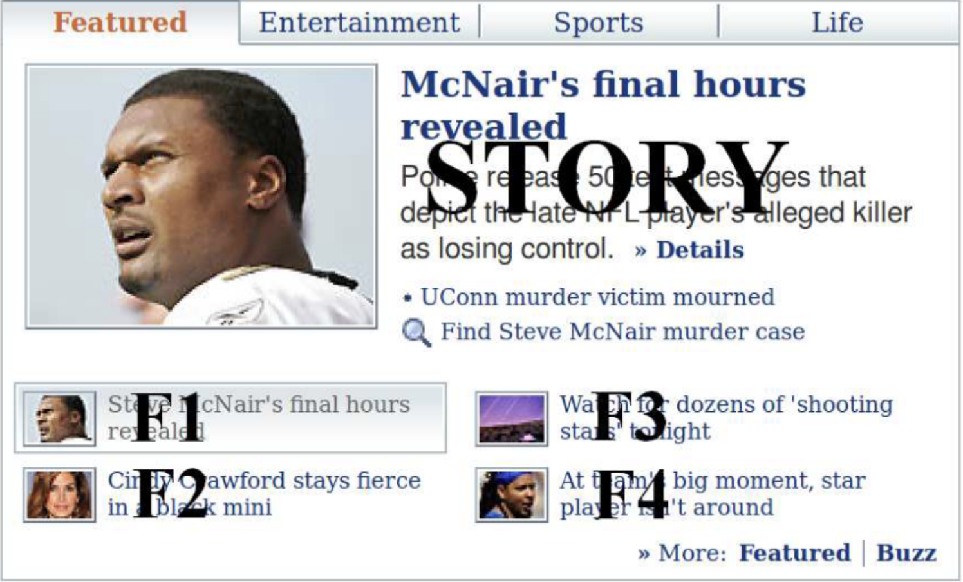
Overview
• Focus on how Yahoo’s Today module works (Story position, articles F1-F4).
• Goal : maximize engagement by personalizing article recommendations.
Li, L., Chu, W., Langford, J., & Schapire, R. E. (2010). A contextual-bandit approach to personalized news article recommendation. In Proceedings of the 19th international conference on World wide web (WWW '10)
Notes:
The Today module on Yahoo’s homepage highlights one article at a time in the Story position. This article is selected from a pool of four editor-chosen articles, which are updated every hour. The goal is to show users the article they are most likely to click on, based on their personal preferences.”

Slide 17
Data Collection
• Time: May 2009
• Amount:83 million events.
• Each user interaction event consists of three components:
the random article chosen to serve the user
user/article information
whether the user clicks on the article at the story position.
Li, L., Chu, W., Langford, J., & Schapire, R. E. (2010). A contextual-bandit approach to personalized news article recommendation. In Proceedings of the 19th international conference on World wide web (WWW '10)
Notes:
“In May 2009, we collected around 83 million user interaction events from a random bucket, tracking how often users clicked on the article highlighted in the Story position. The articles shown to users were selected randomly from an article pool.”

Slide 18
Feature Construction
Over 1000 user features, 100 article features considered.
Categorical user and article features were encoded as binary vectors, normalized to unit length, augmented with a constant value of 1, resulting in article vectors with 83 entries and user vectors with 1193 entries
1. Demographic Information: Gender and Age
2. Geographic Features: Metropolitan Locations and U.S. States
3. Behavioral Categories: Consumption History
1. URL Categories
2. Editor Categories
Li, L., Chu, W., Langford, J., & Schapire, R. E. (2010). A contextual-bandit approach to personalized news article recommendation. In Proceedings of the 19th international conference on World wide web (WWW '10)
Notes:
“To model user preferences, we constructed detailed feature vectors for both users and articles. These included demographic data like gender and age, as well as behavioral categories summarizing users’ past interactions on Yahoo. For articles, we used URL categories and editorial tags to summarize the content.”

Slide 19
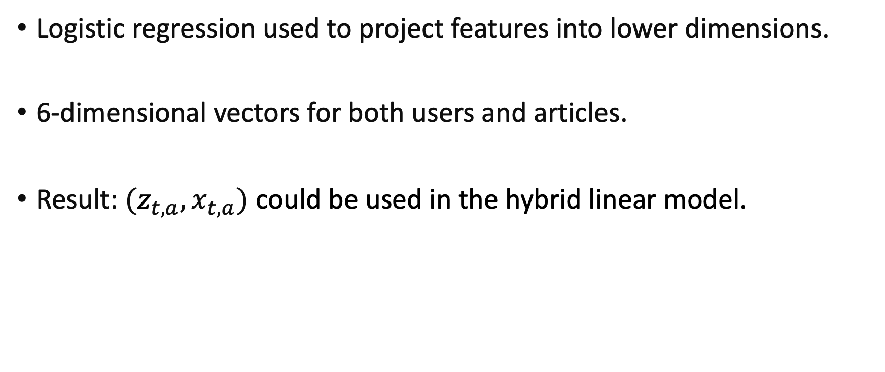
Dimensionality Reduction
Logistic regression used to project features into lower dimensions.
6-dimensional vectors for both users and articles.
Result: $(z_{t,a},x_{t,a})$ could be used in the hybrid linear model.
Li, L., Chu, W., Langford, J., & Schapire, R. E. (2010). A contextual-bandit approach to personalized news article recommendation. In Proceedings of the 19th international conference on World wide web (WWW '10)
Notes:
“To make this model more efficient, we used logistic regression to project the user and article features into lower dimensions. This allowed us to represent users’ preferences for different types of articles using just six values, simplifying the model while still accurately predicting interactions.”

Slide 20
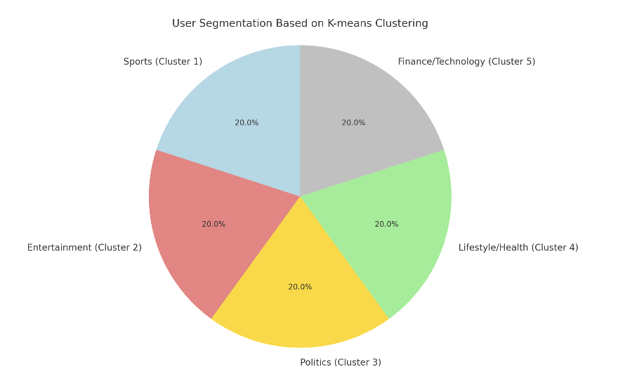
Clustering Users
K-means clustering groups users into 5 clusters based on preferences.
Result: simplifies interaction modeling.
Example：
Li, L., Chu, W., Langford, J., & Schapire, R. E. (2010). A contextual-bandit approach to personalized news article recommendation. In Proceedings of the 19th international conference on World wide web (WWW '10)
Notes:
“Next, we applied K-means clustering to group users into five distinct clusters based on their preferences. This step further simplified the personalization process by categorizing users into one of five groups, allowing us to predict which article they’re most likely to click on.”

Slide 21
Model Efficiency
Reduced feature space balances accuracy and practical performance for online services.
Li, L., Chu, W., Langford, J., & Schapire, R. E. (2010). A contextual-bandit approach to personalized news article recommendation. In Proceedings of the 19th international conference on World wide web (WWW '10)
Notes:
“By reducing the feature space and clustering users, the model becomes more practical for real-time online services. Storing and retrieving smaller feature sets makes the process more efficient, helping Yahoo deliver personalized content quickly while still maintaining high accuracy.”

Slide 22
Part 4: Result & Conclusion
Lecturer: Shirley-Keying Wang
Li, L., Chu, W., Langford, J., & Schapire, R. E. (2010). A contextual-bandit approach to personalized news article recommendation. In Proceedings of the 19th international conference on World wide web (WWW '10)

Slide 23
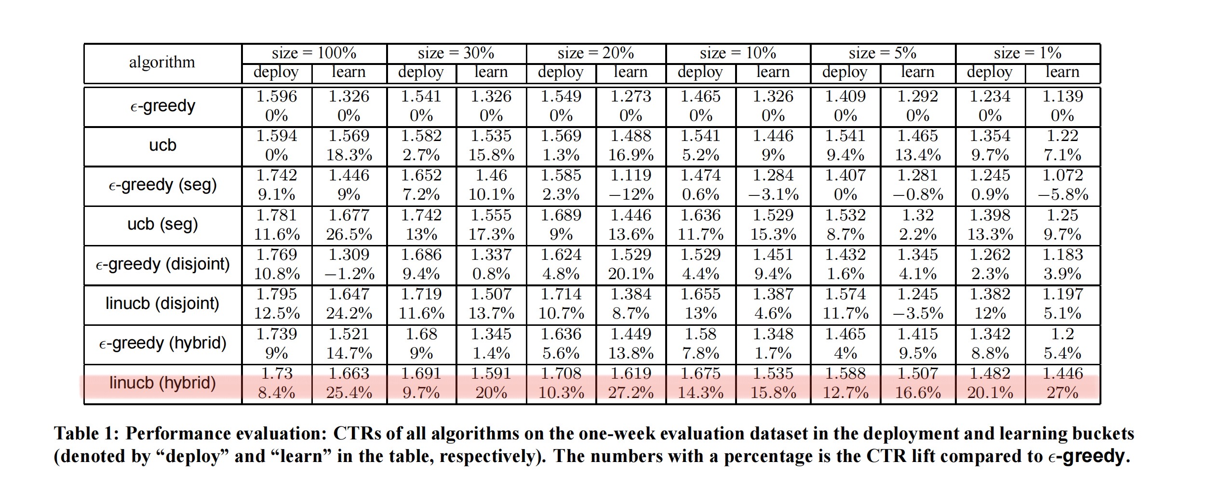
Overall Performance
Li, L., Chu, W., Langford, J., & Schapire, R. E. (2010). A contextual-bandit approach to personalized news article recommendation. In Proceedings of the 19th international conference on World wide web (WWW '10)

Slide 24
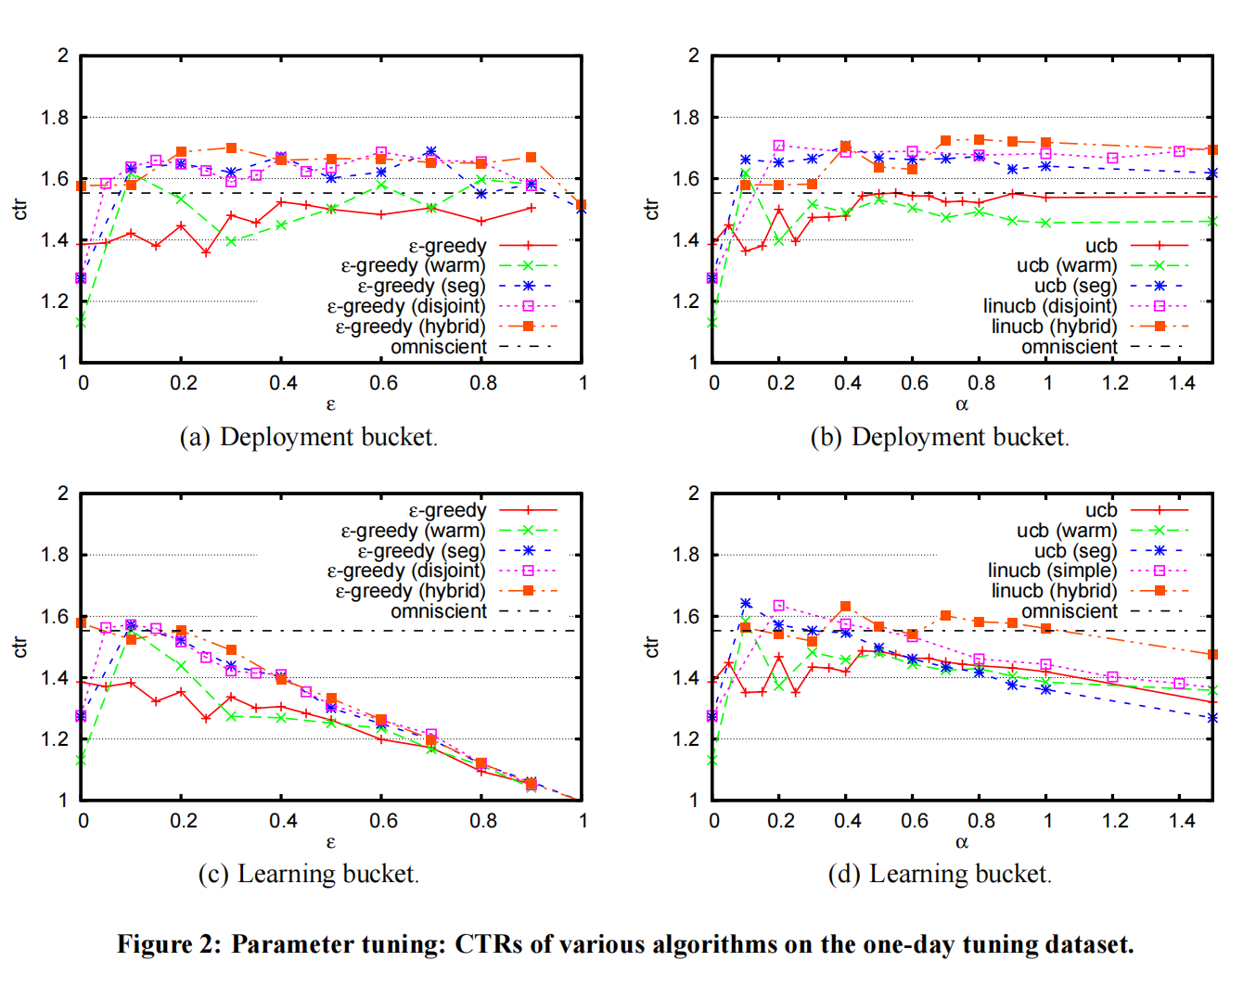
Performance of the ε-Greedy Algorithm
ε-Greedy approaches are unguided because they choose articles uniformly at random for exploration.
Li, L., Chu, W., Langford, J., & Schapire, R. E. (2010). A contextual-bandit approach to personalized news article recommendation. In Proceedings of the 19th international conference on World wide web (WWW '10)

Slide 25
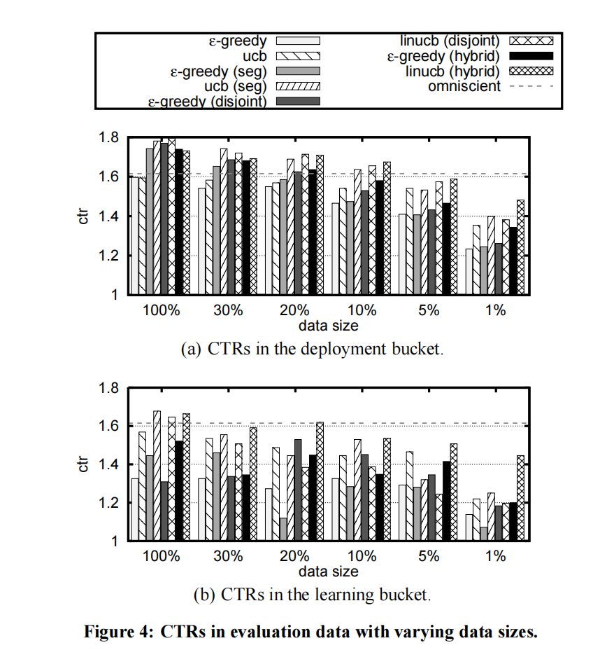
Advantages of UCB1 Algorithm
UCB outperformed ε-greedy ones in the deployment bucket.
More apparent when data size was smaller!
In contrast, exploration in upper confidence bound methods are effectively guided by confidence intervals—a measure of uncertainty in an algorithm’s CTR estimate.
Li, L., Chu, W., Langford, J., & Schapire, R. E. (2010). A contextual-bandit approach to personalized news article recommendation. In Proceedings of the 19th international conference on World wide web (WWW '10)

Slide 26
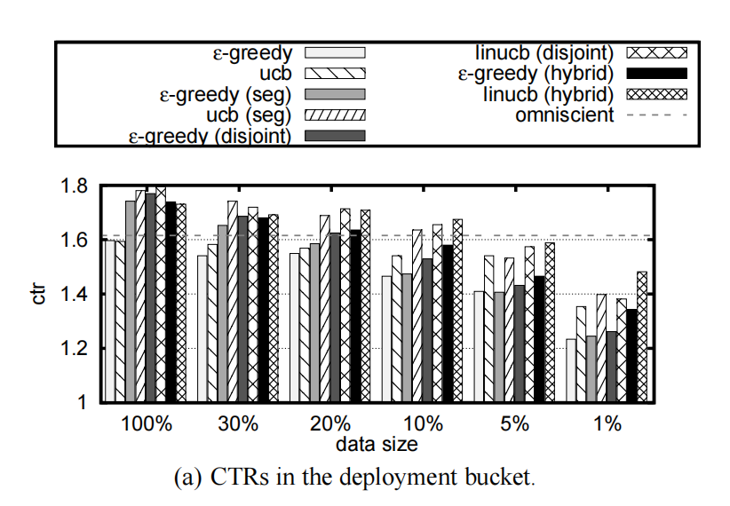
LinUCB (Disjoint Model) vs LinUCB (Hybrid Model)
LinUCB (hybrid) showed significant benefits when data size was small.
Some features are shared by all articles, making it possible for CTR information of one article to be “transferred” to others.
In contrast, in disjoint models, feedback of one article may not be utilized by other articles
Li, L., Chu, W., Langford, J., & Schapire, R. E. (2010). A contextual-bandit approach to personalized news article recommendation. In Proceedings of the 19th international conference on World wide web (WWW '10)

Slide 27
Conclusions
Advantages of LinUCB (Hybrid Model): in data-sparse environments when dealing with large content pool
Effectiveness of UCB-based Algorithms: better-guided exploration
Future Work: extend the use of Bandit algorithms
Li, L., Chu, W., Langford, J., & Schapire, R. E. (2010). A contextual-bandit approach to personalized news article recommendation. In Proceedings of the 19th international conference on World wide web (WWW '10)

Slide 28
Contributions
Tommy - Tongle Shen(Group Leader): Slides Part2(algorithm), paper reading, distribute works, managing progress, review and suggest revisions for slides
Andy - Yuxuan Yang: Slides Part1(Introduction), paper reading
Zach - Chenhao Zhu: Slides Part3(Experiment), paper reading, verification with code and preprocessed dataset
Shirley - Keyin Wang: Slides Part4(Conclusion), paper reading
Li, L., Chu, W., Langford, J., & Schapire, R. E. (2010). A contextual-bandit approach to personalized news article recommendation. In Proceedings of the 19th international conference on World wide web (WWW '10)

Slide 29
References
A Contextual-Bandit Approach to Personalized News Article Recommendation, Lihong Li, Wei Chu, John Langford, Robert E. Schapire 2010.02 WWW '10: Proceedings of the 19th international conference on World wide web
https://banditalgs.com/2016/10/19/stochastic-linear-bandits/
https://courses.cs.washington.edu/courses/cse599i/18wi/resources/lecture10/lecture10.pdf
https://github.com/yijunquan-afk/bandit-learning/tree/master/03-papers
Li, L., Chu, W., Langford, J., & Schapire, R. E. (2010). A contextual-bandit approach to personalized news article recommendation. In Proceedings of the 19th international conference on World wide web (WWW '10)

